Slide 1
InfoSec Technical Champions Meeting
The Meeting Will Start Soon
2nd Meeting – August 11th, 2021

Slide 2

API’s and Secrets
Kubernetes
Risk of OSS
Networking and Security
Notes:
I was going to show a slide of Olivia Newton John singing “Let’s get technical,” but I opted for another picture. This one. I selected this one because I want us to keep the mindset of constant growth and learning. Those of you in this group are the quintessential Rocket Team Members, so I’m probably preaching to the choir here, but what this group is all about is learning. Constant learning. Technology all around us is growing and changing, we need to be vigilant and do the same.

Slide 3
2nd Technical Champions Meeting August 11th , 2021
Welcome to the 2nd meeting of the Rock FoC Technical Champions!
Welcome back! The Information Security Technical Champions group meetings are the place to be for the Team Members thirst for more technical knowledge!
This session will be another great chance to learn things that may be unfamiliar but alluring. So, please make sure to ask questions, make comments, and get fired up for our very special guest presenters. As always, let us know what additional Technical topics we can have ready for next time. Now let’s learn!
Thank you so much for joining us!

Slide 4

Technical Champions
1st Meeting
Welcome (2 mins) – Mark McMillan
Introductions (2 mins) – Mark McMillan
Protecting API’s and Secrets (20 mins) – Peter Varga
Kubernetes (25 mins) – Matt Counts
Close out and Q+A (5 mins) – Mark McMillan

Slide 5



Short Intro -
Today’s Speakers
Josh Baran
Matt Counts
Peter Varga
Team Leader, Engineering
Software engineer turned leader, responsible for facilitating team success in delivering for other technology teams.
Associate Information Security Engineer
Computer software engineering enthusiast. Grows the greatest beard you’ll see (outside ZZ Top).
Team Leader, Continuous Quality
Obsessed with finding and implementing needed quality/technical solutions for everyone

Slide 6

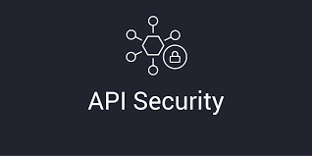
And now… Peter Varga with…
Some Things To Consider
Notes:
This talk will provide you some things to consider – ensuring that we keep our technical secrets, SECRET
We'll go over some basics of API securty - Things like: to not store API signatures, or secrets in plain text: GIT, Code, Pipelines, Postman, etc.
Before users can make requests with your API, they’ll usually need to register for an API key or learn other ways to authenticate the requests.
APIs vary in the way they authenticate users. Some APIs require you to include an API key in the request header, while other APIs require elaborate security due to the need to protect sensitive data, prove identity, and ensure the requests aren’t tampered with
This talk is about working WITH APIs, what does that means
Best practices for considerations when working with APIs
Identifying where sensitive information may appear
Response considerations that impact security
Descriptions of APIs
Understanding what kind of confidentiality considerations went into this
What it isn’t:
How to implement Authorization/Authentication from the API point of view
How to harden an API based on expected usage

Slide 7
API Breakdown: (A Refresher)
Headers
Request Body
Return Body
Verb (GET, POST, DELETE, etc.)
Authentication
None
API Key
Bearer Token
Basic (user name/pwd)
OAuth (1 + 2)
Others (JWTs, Hawk, AWS Signature Digest, NTLM, etc.)...
Parameters are Key / Value pairs - Separated by ? -- Additional values by &
Header Parameters (request headers)
Parameters included in the request header, usually related to authorization
Path Parameters
Parameters within the path of the endpoint, before the query string (?). These are usually denoted within curly braces
Query String Parameters
Parameters in the query string of the endpoint, after the ?
Notes:
This is a breakdown of what APIs are made up of...
So which ones could potentially cause a security issue/breach?
Answer: ALL of these data points -- are potential attack vectors
We should constantly be checking for PII/PIFI, Secrets, and other sensitive information in EACH of these data points
Web applications/web services use input from HTTP requests (and occasionally files) to determine how to respond
Attackers can tamper with any part of an HTTP request, including the URL, query strings, headers, cookies, form fields, and hidden fields, to try to bypass the site’s security mechanisms
Common names for common input tampering attacks include: forced browsing, command insertion, cross site scripting, buffer overflows, format string attacks, SQL injection, cookie poisoning, and hidden field manipulation
Depending what you are testing or how you are using the API, we should be on the look-out for:
Authentication:
Protectiing HTTP (Verb) Methods
RESTful APIs often use GET (read), POST (create), PUT (replace/update) and DELETE (to delete a record).
Not all of these are valid choices for every single resource collection, user, or action.
Make sure the incoming HTTP method is valid for the session token/API key and associated resource collection, action, and record.
Whitelistiing Allowable Methods
It is common with RESTful services to allow multiple methods for a given URL for different operations on that entity.
For example, a GET request might read the entity, while PUT would update an existing entity, POST would create a new entity, and DELETE would delete an existing entity.
It is important for the service to properly restrict the allowable verbs such that only the allowed verbs would work, while all others would return a proper response code (for example, a 403 Forbidden)
Security Related Headers:
x-content-type: nosniff, - https://developer.mozilla.org/en-US/docs/Web/HTTP/Headers/X-Content-Type-Options
content security policies - https://developer.mozilla.org/en-US/docs/Web/HTTP/CSP
cookies set to HttpOnly, and Secure - https://developer.mozilla.org/en-US/docs/Web/HTTP/Cookies
Parameters
Request and Response Bodies
Usually, the header just includes authorization parameters that are common across all endpoints; as a result, the header parameters aren’t usually documented with each endpoint.
Instead, the authorization details in header parameters are documented in the authorization requirements section.
However, if some endpoints require unique parameters to be passed in the header, you would document them in the parameters documentation within each endpoint.
By manipulating these parameters, attackers may be able to access other information that was not expected
For example: Broken Access Control (aka an "enumeration attack") : OWASP A5: If parameters contain user or accounts IDs in a URL
If a path parameter has an ID: 1234 > Choose any other ID – and you could see another "account" - by merely selecting other parameter values)
Source: Header: Authorization https://developer.mozilla.org/en-US/docs/Web/HTTP/Headers/Authorization
Source: https://idratherbewriting.com/learnapidoc/docapis_doc_parameters.html
Source: https://owasp.org/www-project-top-ten/2017/A5_2017-Broken_Access_Control
Source: https://dzone.com/refcardz/rest-api-security-1#section-2

Slide 8
API Security Basics
Authentication : Who you are : Proves correct identity
Authorization : What you can do : Allows certain actions
Integrity : Message consistency before/after transit
Non-repudiation : Proven receipt / No denial
Confidentiality : Secured message during transit
Notes:
Security basics
When looking at any security aspect, often a lot of terms get thrown around which can be overwhelming and also confusing. Therefore, before looking at the nitty-gritty of securing RESTful APIs it is worth getting some security jargon out of the way.
Authentication - Establish the sender’s identity so that receiver knows who they are talking to; e.g. client (user, device, or another service/API) sends credentials (either in plaintext or encrypted) to the server to identify itself.
Authorization - Verification what that the sender has access to. Happens post authentication to determine whether they have access to a certain resource.
Integrity - Ensuring message contents of a request haven’t changed in transit.
Non-repudiation - Ensuring that the sender cannot deny having sent the message; e.g. your bank cannot deny having sent you a bank statement if it has a valid stamp of the bank on it and this could be proved to a third party.
Confidentiality - No one can see the message contents in transit from sender to receiver.
Why do APIs even need authentication? For read-only APIs, sometimes users don’t need keys. But most commercial APIs do require authorization in the form of API keys or other methods. If you didn’t have any security with your API, users could make unlimited amounts of API calls without any kind of registration. Allowing unrestricted requests would make a revenue model for your API difficult.
Additionally, without authentication, there wouldn’t be an easy way to associate requests with specific user data. And there wouldn’t be a way to protect against requests from malicious users that might delete another user’s data (such as by making DELETE requests on another’s account).
Finally, you couldn’t track who is using your API, or what endpoints are most used. Clearly, API developers must think about ways to authenticate and authorize requests made to their API.
Overall, authentication and authorization with APIs serves the following purposes:
Authenticate calls to the API to registered users only
Track who is making the requests
Track usage of the API
Block or throttle any requester who exceeds the rate limits
Apply different permission levels to different users
Source: https://hemantkumar.net/securing-rest-apis.html

Slide 9
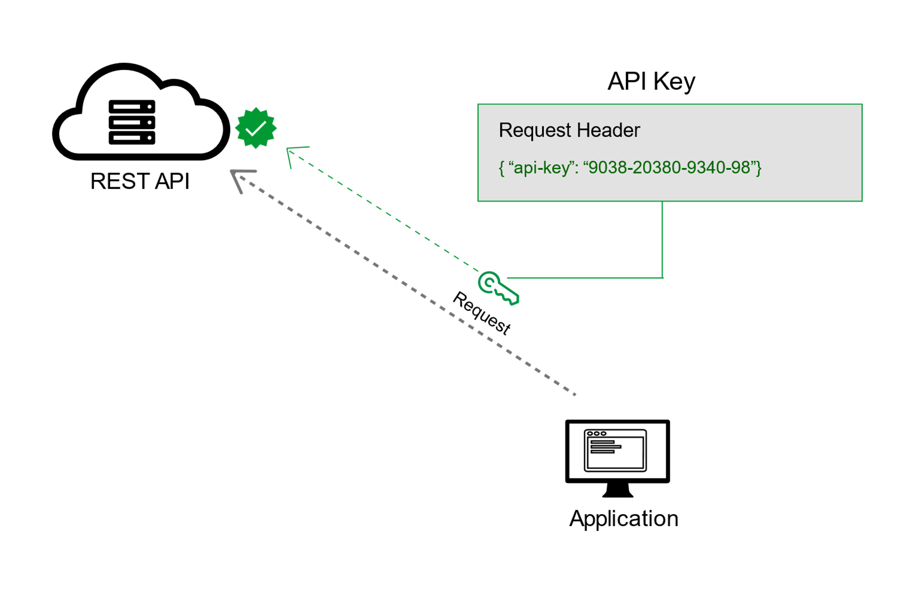
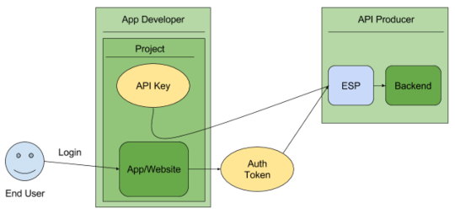
Let's Focus on Authentication: API Keys (and Tokens)
An application programming interface key (API key) is a unique identifier used to authenticate a user, developer, or calling program to an API
Notes:
The difference between API Keys and Auth Tokens:
API keys identify the calling project — the application or site — making the call to an API.
Authentication tokens identify a user — the person — that is using the app or site.
An API key is issued by a back-end service provider to identify the developer and/or app accessing it. The API key may be split into ID and secret strings, or both the ID may be opaquely encoded into a single string. The secret or encoded key may also contain additional information such as an expiration date.
To use an API, a developer registers his application with the API service and receives a unique key to use when making API requests.
This API key is typically used to identify the calling app, impose rate and quota limits on the calling app, restrict the app to a subset of the API’s capabilities, and/or bill the developer for services used.
The API key is sent as part of each API call. That key is easily observed or tampered with over an HTTP request, so using HTTPS (TLS) is imperative. However, even using HTTPS, devices are vulnerable to man-in-the-middle attacks, so additional techniques, such as certificate pinning [REF] are recommended but too often unadopted because of implementation and maintenance complexities.
Most APIs require you to sign up for an API key in order to use the API. The API key is a long string that you usually include either in the request URL or request header. The API key mainly functions as a way to identify the person making the API call (authenticating you to use the API). The API key might also be associated with a specific app that you register.
APIs might give you both a public and private key. The public key is usually included in the request, while the private key is treated more like a password and used only in server-to-server communication. For some API documentation sites, when you’re logged into the site, your API key automatically gets populated into the sample code and API Explorer.
API keys are generally not considered secure; they are typically accessible to clients, making it easy for someone to steal an API key. Once the key is stolen, it has no expiration, so it may be used indefinitely, unless the project owner revokes or regenerates the key. While the restrictions you can set on an API key mitigate this, there are better approaches for authorization.
Source: https://hackernoon.com/improve-the-security-of-api-keys-v5kp3wdu
Source: https://idratherbewriting.com/learnapidoc/docapis_more_about_authorization.html#consequences-if-an-api-lacks-security
Source: https://cloud.google.com/endpoints/docs/openapi/when-why-api-key

Slide 10
Securing an API key: Best Practices
Secured at rest and in transit
API keys are not embedded in code, files, or source code
Setup API key restrictions
Delete unused API keys
Rotate your API keys
Review your code / security vectors, especially before release to PROD
Notes:
When you use API keys in your applications, ensure that they are kept secure during both storage and transmission. Publicly exposing your credentials can result in your account being compromised, which could lead to unexpected charges on your account. To help keep your API keys secure, follow these best practices:
Do not embed API keys directly in code. API keys that are embedded in code can be accidentally exposed to the public. For example, you may forget to remove the keys from code that you share. Instead of embedding your API keys in your applications, store them in environment variables or in files outside of your application's source tree.
Do not store API keys in files inside your application's source tree. If you store API keys in files, keep the files outside your application's source tree to help ensure your keys do not end up in your source code control system. This is particularly important if you use a public source code management system such as GitHub.
Set up application and API key restrictions. By adding restrictions, you can reduce the impact of a compromised API key.
Delete unneeded API keys to minimize exposure to attacks.
Regenerate your API keys periodically. You can regenerate API keys from the Credentials page by clicking Regenerate key for each key. Then, update your applications to use the newly-generated keys. Your old keys will continue to work for 24 hours after you generate replacement keys.
Review your code before publicly releasing it. Ensure that your code does not contain API keys or any other private information before you make your code publicly available.

Slide 11

Keep Secrets out of SDLC Channels and Pipelines: Protect our API Keys (HMAC)
Notes:
Protect: API signatures, keys and secrets
It's a lot harder for malicious hackers to do bad things when we hide our keys
One way to improve security is to keep the API key out of the entire SDLC channel. Instead of adding the plaintext API key to a request, we will use the API key to sign each request and the API verify the request signature
This is typically done using a hash-based message authentication code (HMAC).
The API call is still sent in plain text over HTTPS, so the message could be observed if HTTPS is defeated.
However, the HMAC signature ensures that this message has not been tampered with, and we have improved API security because the API key itself is no longer visible in the API call.
At its most vulnerable, the key will be a static constant easily found within the application package.
As a first step, use code obfuscators, though still not good, is to make it difficult to locate and extract the secret, and consider encoding a static secret in some computationally simple way, perhaps cutting up and distributing the encoded secret across multiple locations within the binary.
Reassemble and decode the secret in memory as needed, and never store the decoded and reassembled API key on the device.
Do what you can to make reverse engineering the application as difficult as possible, without exceeding performance and effort budgets.
Regardless of your efforts, it is not a matter of if a secret will be stolen, but if the time and effort to steal it is worth the return.
Make it as difficult as you can afford. If an API secret is stolen from one device, all app instances will be compromised until we upgrade the entire installed base with a new secret and a new technique to obscure it.
Source: https://hackernoon.com/improve-the-security-of-api-keys-v5kp3wdu

Slide 12
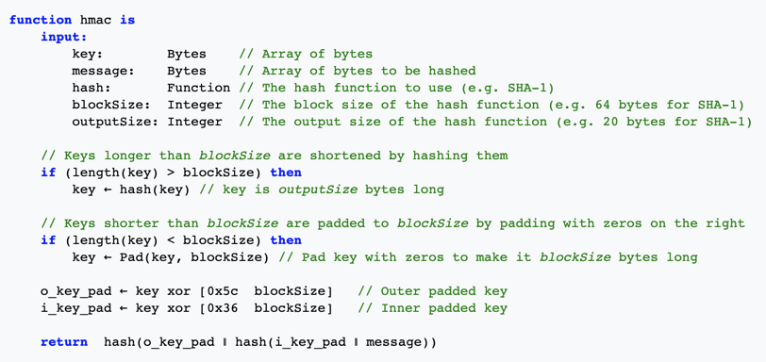
HMAC Example
The following pseudocode demonstrates how HMAC may be implemented:
Examples:
- HMAC_MD5("key", "The quick brown fox jumps over the lazy dog") = 80070713463e7749b90c2dc24911e275
- HMAC_SHA1("key", "The quick brown fox jumps over the lazy dog") = de7c9b85b8b78aa6bc8a7a36f70a90701c9db4d9
- HMAC_SHA256("key", "The quick brown fox jumps over the lazy dog") = f7bc83f430538424b13298e6aa6fb143ef4d59a14946175997479dbc2d1a3cd8
Notes:
HMAC (sometimes expanded as either keyed-hash message authentication code or hash-based message authentication code) is a specific type of message authentication code (MAC) involving a cryptographic hash function and a secret cryptographic key.
As with any MAC, it may be used to simultaneously verify both the data integrity and the authenticity of a message.
HMAC can provide message authentication using a shared secret instead of using digital signatures with asymmetric cryptography.
It trades off the need for a complex public key infrastructure by delegating the key exchange to the communicating parties, who are responsible for establishing and using a trusted channel to agree on the key prior to communication.
Source: https://en.wikipedia.org/wiki/HMAC

Slide 13
InfoSec Guidance
Encryption to Protect Sensitive Information
Hashing
Masking Sensitive Data
Example: *****
Notes:
Encryption to Protect Sensitive Information
Encryption must be used to protect the confidentiality of sensitive information (e.g., Personally Identifiable Information (PII), Personally Identifiable Financial Information (PIFI), etc.) in transit (i.e., to, from, and between Company systems and/or third party systems), and in the location where the data is stored when not in use (i.e., data at rest). Users must comply with the Company’s data classification standards and data handling standards when storing, transmitting, or manipulating sensitive information.
Hashing is a one-way function where a unique message digest is generated from an input file or a string of text. No keys are used.
The message is encoded in a way that only authorized parties can access it. It's used to prevent unauthorized users from reading data from a file by rendering it into an unreadable form
Masking Sensitive Data
The display and printing of passwords and Personally Identifiable Financial Information (PIFI) should be masked or obfuscated so that unauthorized parties cannot observe and/or subsequently recover them. This includes both masking within applications, for example, by replacing sensitive data with a # or other character; and, masking within data storage using approved encryption and/or hashing methods.
User IDs should not be displayed unless there is a specific business requirement or functional requirement for end user interaction.
Passwords should never be displayed within an application or as clear text in data storage.
Display and printing of Personally Identifiable Information (PII) and PIFI should be handled in accordance with the Company’s Information Handling Standards as established in the Risk Management section of the IT Information Security Policy.
Source: https://uploads.wpallin.backbone.foc.zone/wp-content/uploads/2020/09/29131335/Information-Security-Policy-for-Technology-TMs.pdf

Slide 14
InfoSec Guidance (Continued)
Encrypting Sensitive Information Prior to Internet Transmission
Information classified as "Sensitive" must not be sent over the Internet
Examples of information that must be encrypted include,
(but are not limited to):
Credit card numbers or other cardholder information
Passwords / API Keys
Research and development information
Healthcare-related information and Personally Identifiable Health Information (PIHI)
Business Sensitive information
Business Confidential information
Social Security Numbers
Other PIFI, PII, PIE
Notes:
Encrypting Sensitive Information Prior to Internet Transmission
Information classified as Sensitive must not be sent over the Internet (e.g., email, ftp), via remote access or other external networks unless the message is using an encryption method approved by Information Security.
Examples of information that must be encrypted include, but are not limited to:
• Credit card numbers or other cardholder information
• Passwords
• Research and development information
• Healthcare-related information and Personally Identifiable Health Information (PIHI)
• Business Sensitive information • Business Confidential information
• Social Security Numbers
• Other PIFI PII PIE

Slide 15

No Keys in our Device/Pipelines!
Notes:
The best API key is one that is never present in our source control, communication channels, persistent storage, deployment pipelines, applications, or the application code.
So far we’ve hidden the key inside the code, by never committing our APIs into source control, but can we really remove it from the application code altogether?
For starters, consider providing the API key remotely on an as needed basis. When your app is ready to make an API call, it can request the API key from this remote service, like SecretServer or the Vault, or by including it in CircleCI or TFS deployment variables – To be injected at runtime. (Similar to Docker/Kubernetes – which is a discussion for another session)
Similar to the original API calling channel, we don’t want to return the actual API key in this channel. Since there is no message to sign, instead we’ll use a short-lived JSON Web Token (JWT) signed with the API key. Now this API key is known only to the API’s back-end service and the API key service, but not the device nor any of its communication channels.
As it stands, anyone, valid app or malicious bot, can successfully request an API access token. We need a method to verify that the agent requesting the API access token is and only is the authentic app. One way to do this is to register the app with the API key service – such as QKS or AWS Secret Manager
Before the app is ready to make an API call, it will request that it’s authenticity be verified.
Through a cryptographically complete and unreplayable challenge-response protocol, the API key service will decide whether the app is authentic, uncompromised, and running in a trustworthy environment.
If satisfied, it will provide a short-lived API access token properly signed by the API key or, if unsatisfied, an improperly signed token. The app adds the API key token to the API call, and the back end service will validate the API key token, ensuring the app’s identity, before further evaluating the API call.
Source: https://hackernoon.com/improve-the-security-of-api-keys-v5kp3wdu

Slide 16
How / What to document your API Authentication
Document necessary information such as:
How to get/re-cycle API keys (from Vault or SecretServer)
Including token expiration times
How to authenticate requests (Basic, Keys, HMAC, etc.)
Error messages related to invalid authentication:
Usually response codes in response API:
401: Unauthorized (No Authentication provided in request)
Or
403: Forbidden (No Authorization)
Sensitivity around authentication information
PII / PIFI / Tokens, etc.
NOTE: Keep this documentation up-to-date, living within/alongside your code (Think: GHE source control)
FYI: ProTip Consideration : Use OpenAPI Specification (Swagger)
See next slide for an example
Notes:
If you have public and private keys, you should explain where each key should be used, and note that private keys should not be shared.
If different license tiers provide different access to the API calls, these licensing tiers should be explicit in your authorization section or elsewhere.
Since the API keys section is usually essential before developers can start using the API, this section needs to appear at the beginning of your help.

Slide 17
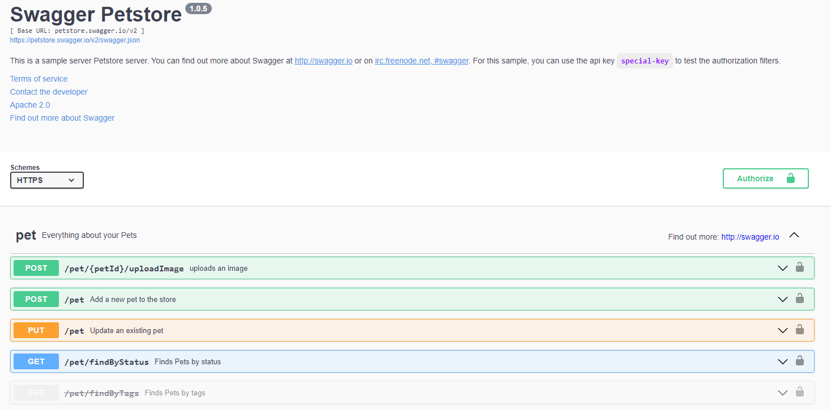
Example of Documentation, using an OpenAPI Spec (Swagger)
Notes:
This is an example of an OpenAPI Specification – You'll notice that it is implemented using Swagger
This lets folks know how to use your API: the verbs allowed, data types for parameters, schemas, and allowable values

Slide 18

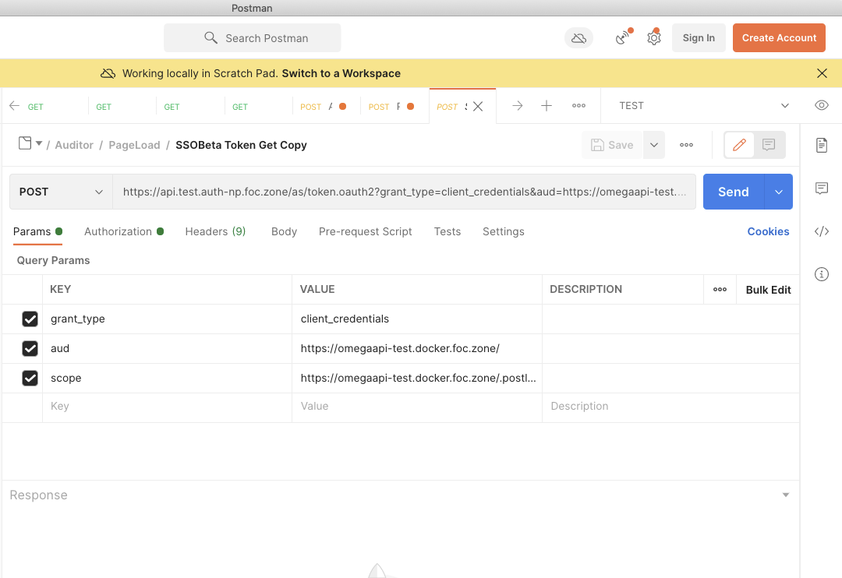
Postman: With Great Power, Comes Great Responsibility
Notes:
One of the most widely tools used within the RocketMortgage enterprise for working with APIs is Postman
This powerful tool help us work with, and test our APIs – to ensure they are working as expected
Let's dive a little deeper into some of the areas of Postman

Slide 19
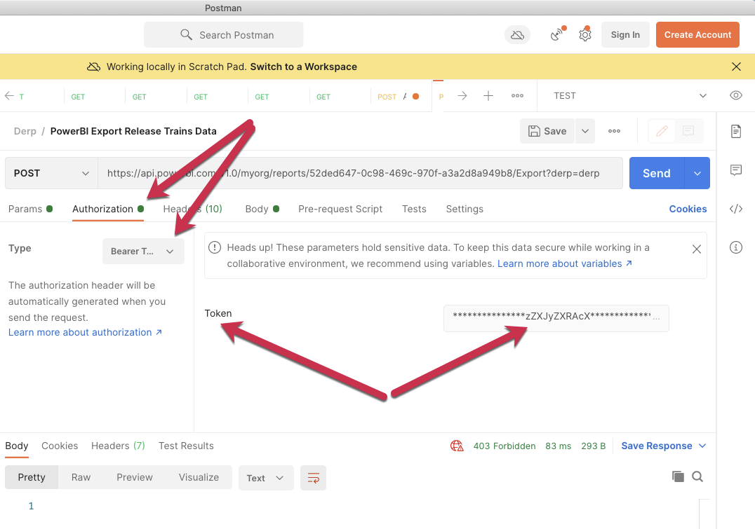
Postman: Auth Example

Slide 20
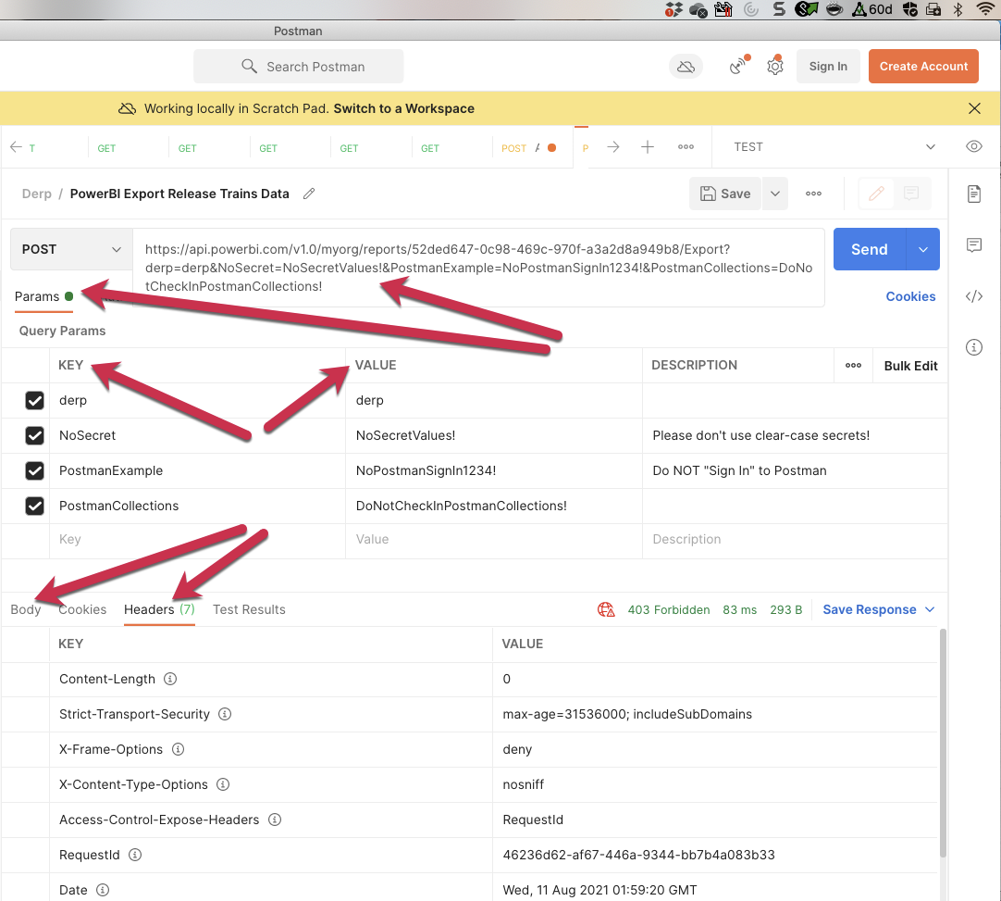
Postman Continued

Slide 21


Stuff To Think About:
Reminders of Security Considerations:
Use Authentication & Authorization
Use API Keys (& User Tokens)
Use Encryption (HMAC)
Document your APIs
Keep secrets out of source code, applications, pipelines, etc.
….
Learn more about Security:
RM Tech GuideBook: shorty/guidebook
OWASP: https://owasp.org/
DZone: https://dzone.com/refcardz/rest-api-security-1
General Security Guidance: shorty/sec101

Slide 22

Questions?
Notes:
Before we get into Q&A - Here is a quick reminder/summary of what we chatted about:
This was a talk about working WITH APIs:
Refresher on working with APIs
Considered some security best practices when working with APIs
Identifying where sensitive information may appear (everywhere!)
Especially think about request/response considerations that impact security – across ALL applications
Understanding what kind of confidentiality considerations went into this
What it isn’t:
How to implement Authorization/Authentication from the API point of view
How to harden an API based on expected usage
If more content on Authorization and Authentication or API design considerations are topics that interest you. Let Mark and/or Joshua know

Slide 23



Kubernetes
Matt counts | Nexsys | x58122

Slide 24
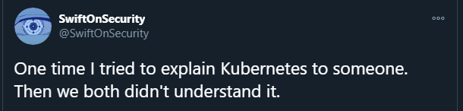
Full Disclosure

Slide 25
What is Kubernetes?
“Kubernetes is a portable, extensible, open-source platform for managing containerized workloads and services, that facilitates both declarative configuration and automation”
- kubernetes.io

Slide 26
What does that mean?
Super short version – it manages containers
Kubernetes makes maintaining a microservice architecture easier by removing the dependency on virtual machines and makes managing dedicated servers easier (nodes)
Huge benefit to cloud native apps or projects.
Developed by Google using Go. Promoted to a full project by the CNCF.
You may also see “K8S” in reference to Kubernetes.

Slide 27
but what does it offer?
High availability, Scalability, and Disaster Recovery
No downtime, high performance, self-healing and can be backed up and restored.
Allows quick configuration and setup through the kubectl cli and the use of yaml or helm charts
Allows for easier IaaS (Infra as a Service) and lets K8S admins be able to easily spin up, remove, or fix infrastructure via a DevOps Pipeline.
Linux based, so its fun and can be secured using the same principals behind securing a Linux machine.
Intercluster networking for pod-to-pod traffic

Slide 28
Vocabulary
Container – Your running code or app bundled together by Docker*
Image – snapshot of your app at a specific moment. (Container == running image)
Pod – What a container “lives” in. One pod can have multiple containers.
A “wrapper” for the container.
Node – The physical machine used for your pods. A node can have multiple pods, or one pod could use multiple nodes
Cluster – Collection of all the Nodes and Pods you need for your system
Your application, load balancing, logging and monitoring, etc.…
AKS – Azure Kubernetes Service
EKS – Elastic Kubernetes Service (AWS)
Kubectl – Kubernetes CLI (Command Line Interface)
Namespace – logical grouping of your pods
K8S API – The “Main Node” and entry point to your cluster

Slide 29
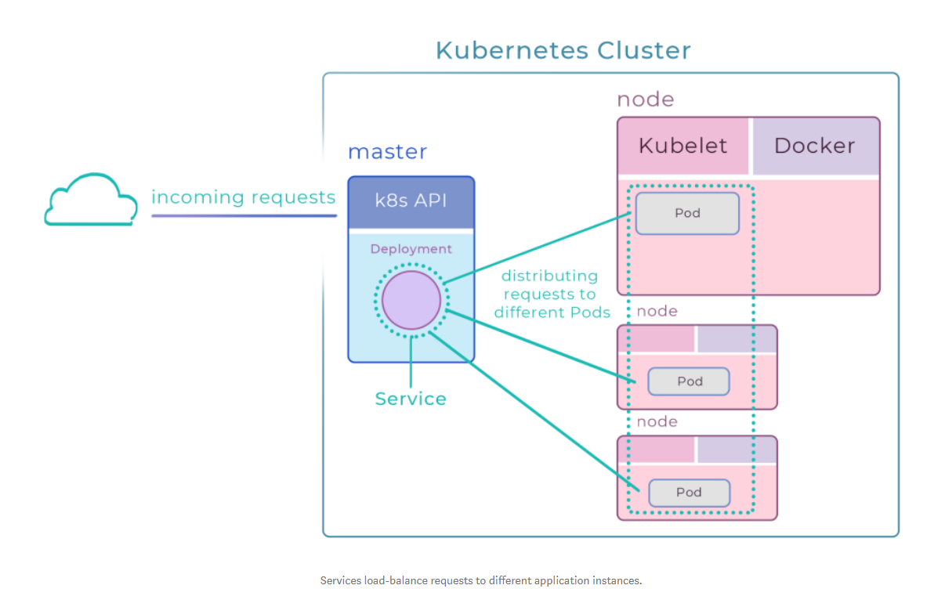
Kubernetes

Slide 30
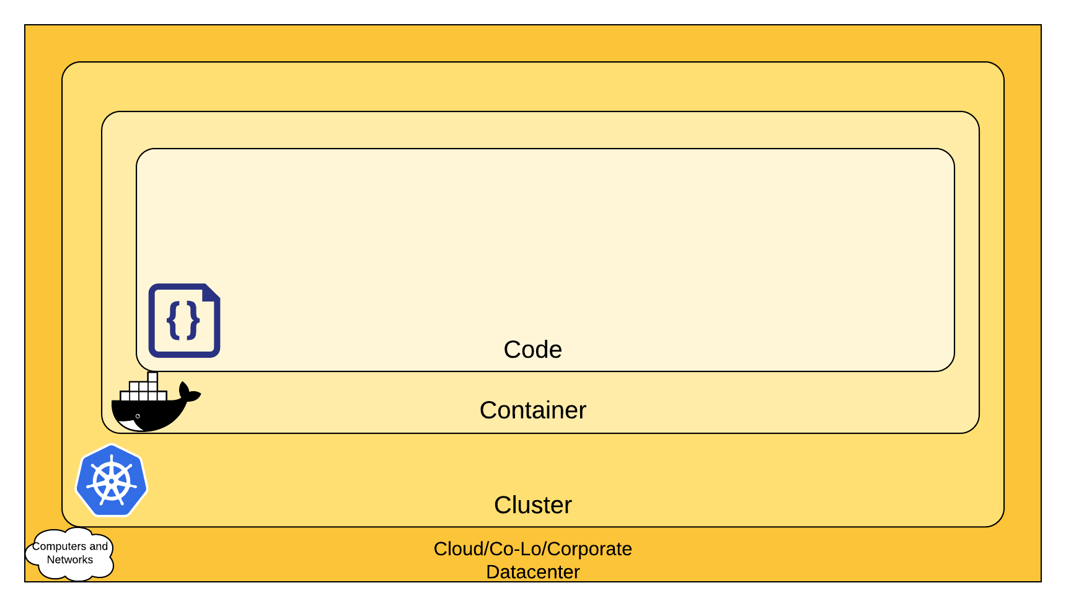
Kubernetes – Defense In Depth

Slide 31

SIDEBAR - Docker
Docker is an open platform for developing, shipping, and running applications.
Keeps your app separate from the infrastructure
Improves stability by removing reliance on host OS.

Slide 32
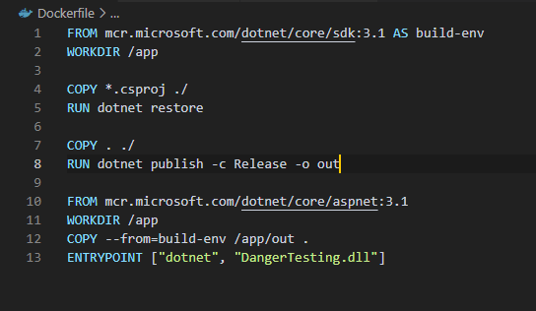
Dockerfile

Slide 33
Securing Kubernetes - basics
Kubernetes does NOT come secure by default! You (or your cloud provider) must make it secure.
Traditionally, this is done with a SecurityContext yaml.
This yaml file establishes what a user can do.
Azure offers RBAC access to AKS, as well as pre-built AKS policies.
AWS also offers RBAC access to EKS.
Kubernetes also has a NetworkContext to handle its internal pod-to-pod networking.
Keep your cluster updated (Most current stable is 1.20.x)
Implement a WAF at the entry point of your cluster!
NGINX with ModSecurity can be both a load balancing pod as well as a firewall!

Slide 34
Securing Kubernetes - Docker Runtime
Runtime security is critical! This is the security of your application while its running in a container.
In the dockerfile (slide 10) is where you would remove linux commands and tools you don’t want running in your container
NEVER RUN AS ROOT! Always create a usergroup and a user for your container.
KNOW YOUR SOURCE! Dockerhub is a great service, but it suffers from the same issues GitHub faces. Only use trusted images.
Make sure you are using HTTPS if your container has APIs

Slide 35
Considerations:
In K8S v. 1.21.x Docker will no longer be supported.
There are other container tools out there to use, so investigating them now may be a good idea.
Cri-o for example
There are tons of tools out there to monitor your container runtime and cluster health – Prisma Cloud Compute, Sysdig Secure, Project Falco, AWS and Azure offerings, etc.
There are also tons of tools to help secure the internal subnet – Cilium, Tigera, cloud-provided resources, etc.

Slide 36
K8s Attacks
/honk

Slide 37

Why honk?
There is a continual meme in the Kubernetes InfoSec world that revolves around a goose behaving badly.
This evolved from an attack known as “A billion laughs”
Based off an older XML injection attack, it was modified to effect K8S clusters via a “YAML Bomb”
Also was inspired by Untitled Goose Game
This involved taking advantage of the K8S Main API and sending it a malicious YAML which would effectively DDoS your cluster.
https://github.com/honk-ci
Discovered by Kubernetes SIG Security co-chair Ian Coldwater
Patched in 1.14.x

Slide 38


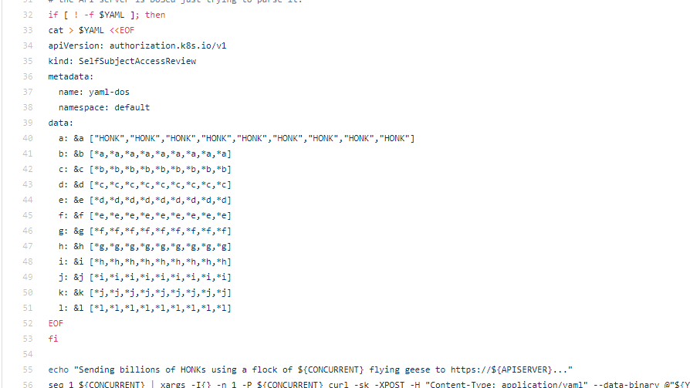
Honk

Slide 39
K8s and APT28
It was recently released that Russian State-Sponsored hackers (Fancy Bear) have been using Kubernetes to perform brute force attacks against companies and governments since 2019
https://media.defense.gov/2021/Jul/01/2002753896/-1/-1/1/CSA_GRU_GLOBAL_BRUTE_FORCE_CAMPAIGN_UOO158036-21.PDF

Slide 40
Dockerhub and monero
There were 23 images on Dockerhub that had Potentially Unwanted Applications (PUA) hidden in them.
The specific PUA was a monero crypto minder.
The image had been downloaded 330,000 times before it was caught.
https://blog.aquasec.com/container-vulnerability-dzmlt-dynamic-container-analysis

Slide 41
Questions?

Slide 42
Resources:
https://docs.docker.com/get-started/overview/
https://docs.docker.com/engine/examples/dotnetcore/
https://docs.docker.com/engine/security/
https://kubernetes.io/docs/reference/kubectl/cheatsheet/
https://kubernetes.io/docs/tutorials/kubernetes-basics/
https://kubernetes.io/docs/concepts/overview/what-is-kubernetes/
https://medium.com/google-cloud/kubernetes-101-pods-nodes-containers-and-clusters-c1509e409e16
https://media.defense.gov/2021/Aug/03/2002820425/-1/-1/1/CTR_KUBERNETES%20HARDENING%20GUIDANCE.PDF

Slide 43

Are there any additional questions or comments?

Slide 44


Brought to you by the:
Thank you everyone for attending this meeting!
Powered by:
We’ll see you again next time!

